Slide 1

CMSE401 Project
Jonathan Dela Cruz

Slide 2
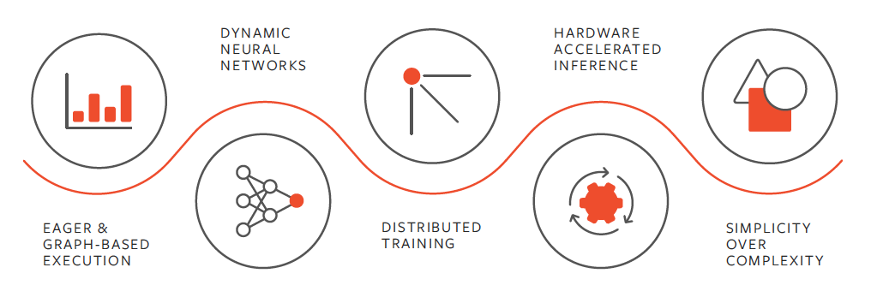
Abstract
Goal: run simulations, in parallel, of each matchup/potential matchup in the 2025 March Madness Tournament
This year, approximately 24.4 million brackets were filled on ESPN Men's Tournament Challenge
Odds of a perfect bracket are about 1 in 9.2 quintillion
How predictable is the tournament?
PyTorch
PyTorch is a fully featured machine learning library used for building deep learning models
Use PyTorch to train a model on previous tournament data

Slide 3
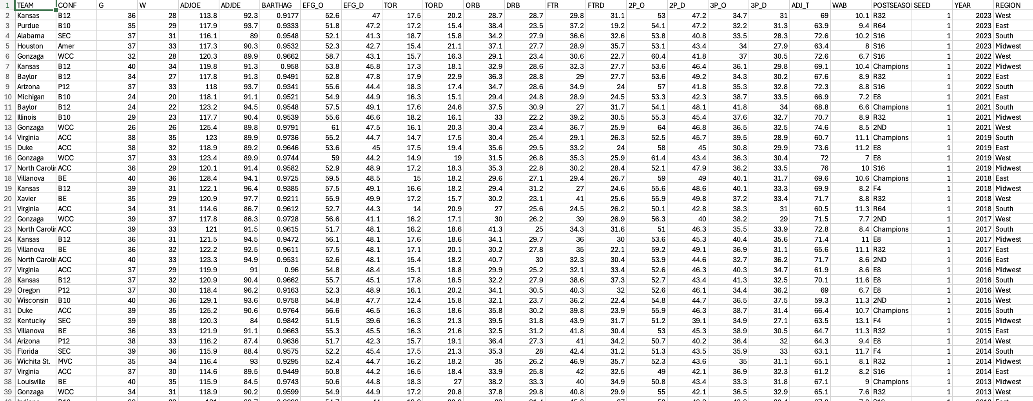
Data Set
Team statistics from the 2013-2023 college basketball seasons (kaggle)
Key Features: Adjusted Offensive/Defensive Efficiency, Wins, Turnover Rate, Offensive Rebounding Rate
Added the "Seed" and "Region" to add to the model and mimic the tournament
Also included data from the 2024 and 2025 college basketball season
2024 data used for testing the model
2025 data used to predict the outcome of the tournament

Slide 4
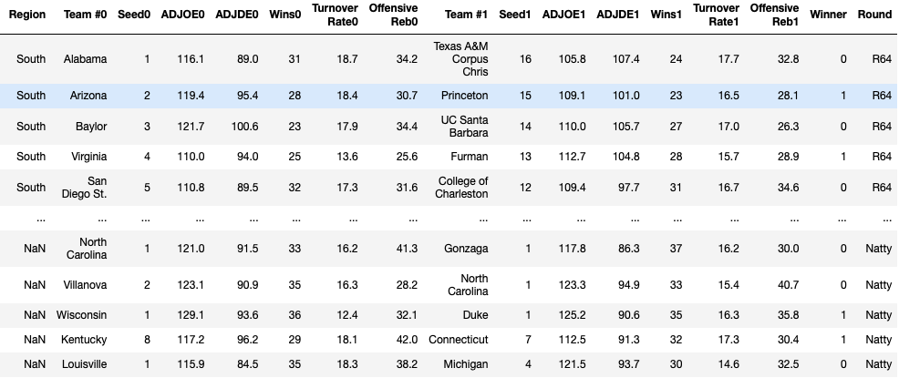
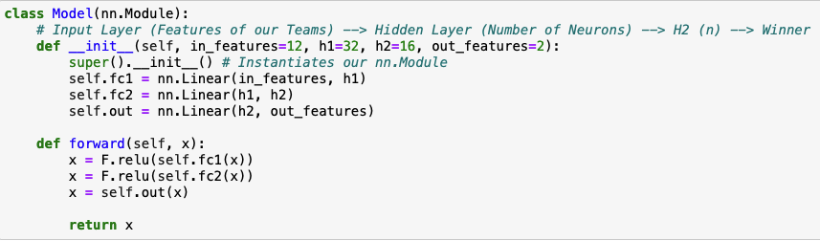
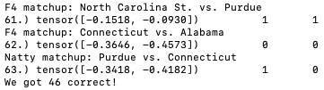
Model
Took our matchup data from the tournament from 2013-2023 and trained our model
Model consists of Input Layer, Hidden Layers, and Output Layer
Used Pandas df.corr() function to see which statistics had a significant correlation with tournament success
The hidden layers are just the number of neurons used to learn the data (tentative)
Output layer is our prediction; Team 0 or Team 1 wins

Slide 5
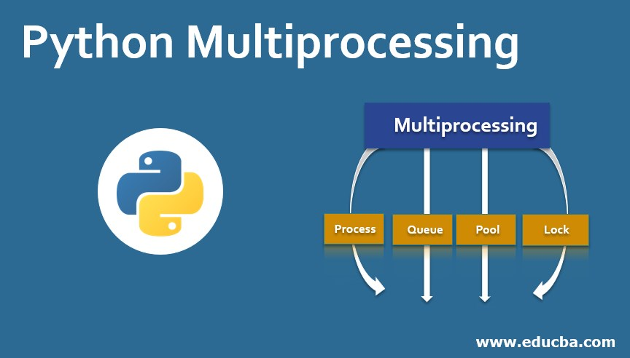
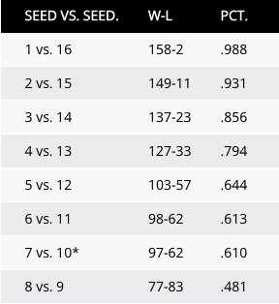
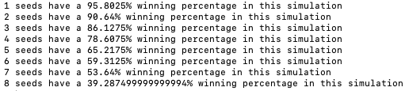
Simulation (In Parallel)
Put our 2025 data through the model; adding noise to imitate unpredictability
For each simulation, the matchup is passed into the model and random noise is added to the corresponding tensors
Running many simulations is computationally expensive
Multiprocessing: the multiprocessing module is a package in python that fully leverages processors on a given machine
Since each game is independent of each other, we can run simulations of each game concurrently instead of one at a time
Pool() function creates a pool of worker processes
Uses multiple CPU cores to simultaneously run simulations
Uses shared memory so each process doesn't make its own copy of the model

Slide 6

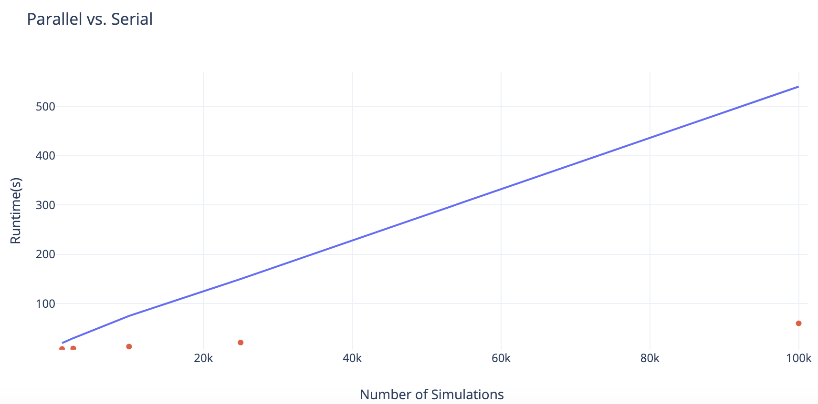
Results
As the number of simulations increases, we can see a significant improvement in runtime and efficiency
1,000 simulations we have a 60% speed up
100,000 simulations we have a 90% speed up
 | 1,000 | 2,500 | 10,000 | 25,000 | 100,000
Serial | ~20 seconds | ~30 seconds | ~75 seconds | ~2.5 minutes | ~9 minutes
Parallel | ~8 seconds | ~9 seconds | ~13 seconds | ~21 seconds | ~1 minute

